Slide 1
Capstone Project Hotel Booking Analysis By Kunal Shinkar Omkar Katare Ganesh Ghadge

Slide 2
Index
Data Summary
Null Values Present In Dataset
Number of bookings cancelled and its percentages of cancellation
Types of Hotels present in Dataset and most preferred among those by the customers.
Number of bookings cancelled across both type of hotels and its percentages of cancellation.
Which are the most trending months of hotel bookings ?
Monthly Bookings by each type of Hotels
Number of Bookings across the years
Month wise Number of waiting Days
Meals ordered by customers
Most preferred stay duration
Average daily rates according to room type
Month and year wise mean ADR
Lead Time vs Cancellation
Country-wise Hotel Booking
Correlation Heat Map Between All Features
Conclusion

Slide 3
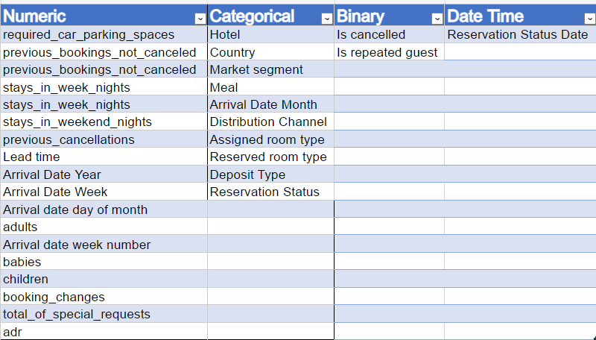
Data Summary

Slide 4
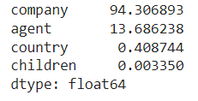
Null Values Present in Dataset
This Dataset consist four columns which contains null values.
For dealing with this null values we drop company and agent column because it contains large amount of Null values.
Country and Children contains very small amount of Null values so that we drop rows from these columns which contains null values.

Slide 5
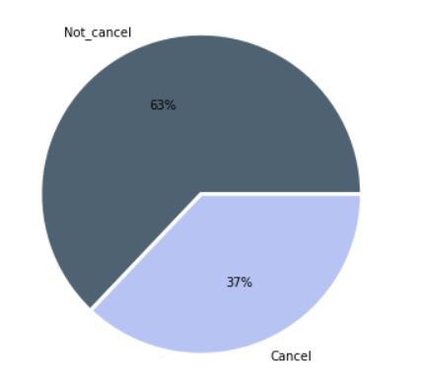
Number of bookings cancelled and its percentages of cancellation
From total number of bookings around 37 % bookings were cancelled.
Confirm bookings was around 63%.
Total bookings = 119206
Confirm bookings = 75011
Cancelled bookings = 44195

Slide 6
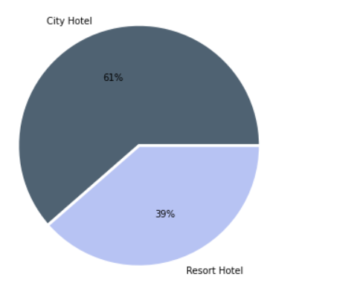
Types of Hotels present in Dataset and most preferred among those by the customers
In this Dataset two types of hotel:
City Hotel
Resort Hotel
From total bookings around 61% bookings came for City hotel & 39% bookings for Resort Hotel

Slide 7
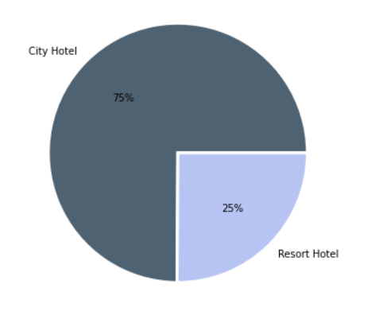
Number of bookings cancelled across both type of hotels and its percentages of cancellation
From this pie chart we can see that cancelling rate is 75% in City hotel
Cancelling rate in Resort hotel is less as compared to city hotel

Slide 8
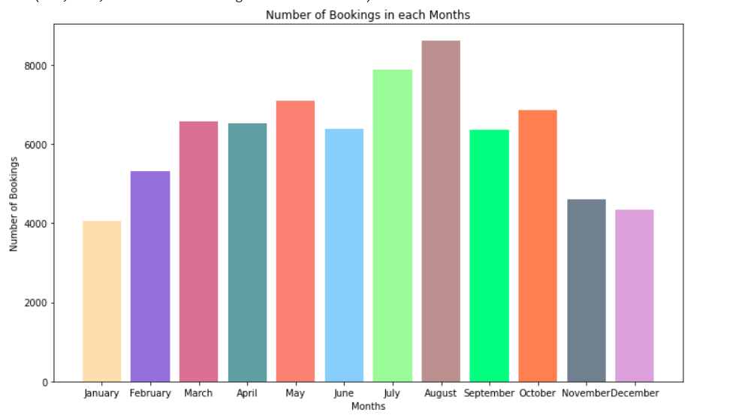
Which is the most trending months of hotel bookings ?
Number of Bookings in August and July month is more as compared to other months
From month march to October number of bookings was pretty good
Number of Bookings decreases in last months of the year

Slide 9
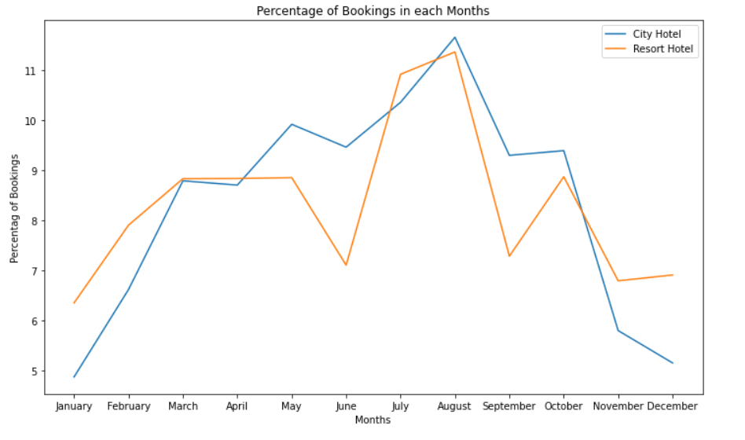
Monthly Bookings by each type of Hotels
Number of bookings for resort hotel constant for March , April and may months.
For months may to September bookings for city hotel is more as compared to resort hotel

Slide 10
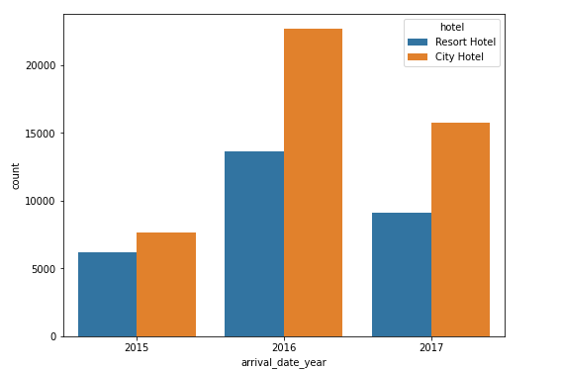
Number of Bookings across the years
The above Countplot between number of confirmed bookings and year of bookings shows that the number of confirmed bookings was lowest in the year 2015 and was highest in the year 2016. In year 2017 we can see a dip in the number of confirmed bookings relative to year 2016. Throughout these years City Hotels had larger share in the bookings received.

Slide 11
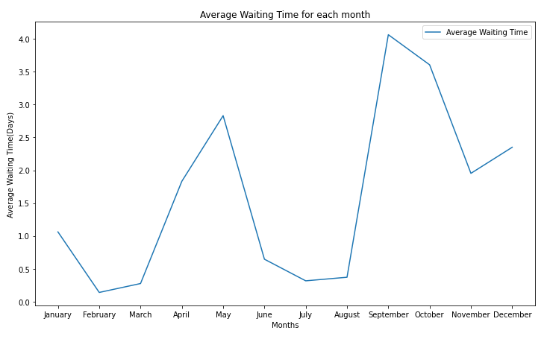
Month wise Number of waiting Days
The above line plot shows that guests had to face least waiting time in the months of February, June , July. And the waiting time was highest in the month of August.

Slide 12
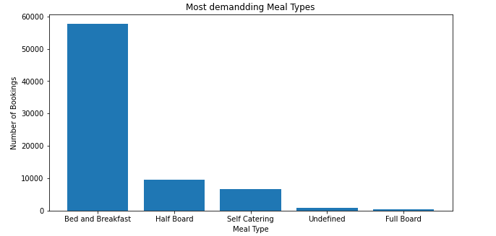
Meals ordered by customers
The above Bar Graph plot shows that ‘Bread and Breakfast’ was the most ordered meal type.

Slide 13
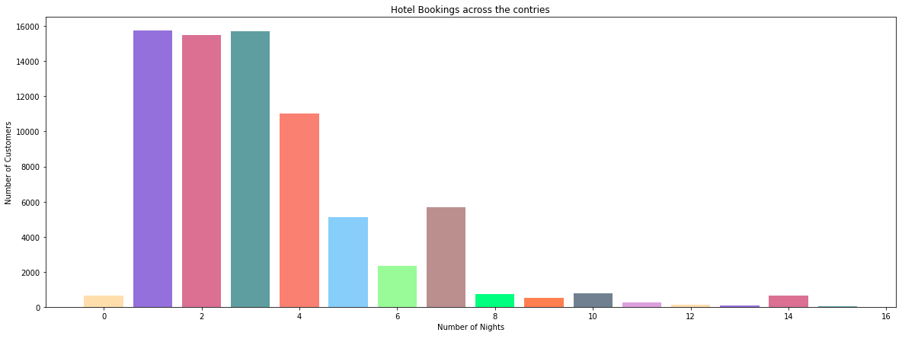
Most preferred stay duration
The above bar graph plot shows that most guests prefer to stay in the hotels for 1 ,2, 3 or 4 nights. There are considerable number of bookings for 7 nights stay.

Slide 14
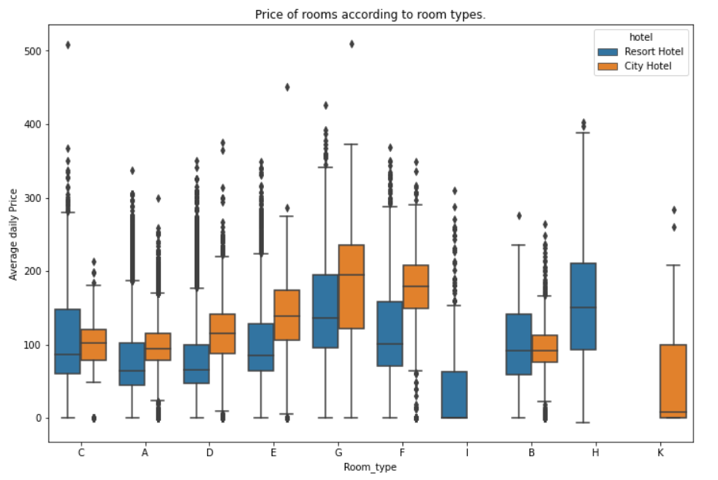
Average daily rates according to room type
We can see that mean ADR were highest for the room type-G and were lowest for room type-K in City Hotels. In case of Resort Hotels mean ADR was highest for room type-H and was lowest for room type-I

Slide 15
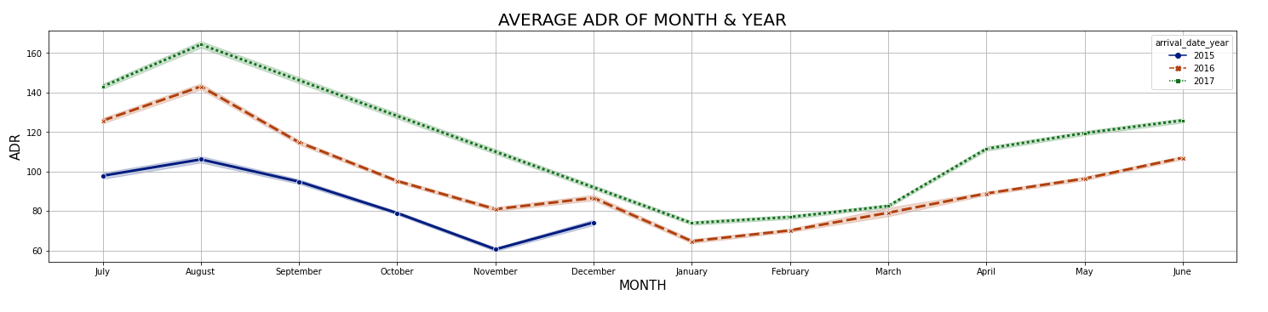
Month and year wise mean ADR
From above plot we can see that ADR was highest in the month of August and it follows a decreasing trend till the month of January from where ADR starts to increase till the month of August . Also on comparing Year on Year basis we can observe that ADR has been consistently increasing.

Slide 16
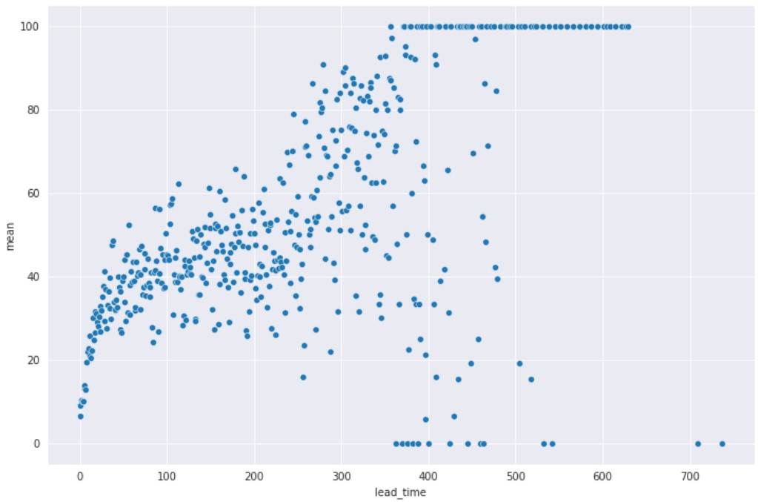
Lead Time vs Cancellation
From the above scatter plot, we can see that the higher lead time has higher chance of cancellation. We have plotted lead_time in X direction and the mean of is_cancelled groupby lead_time in Y direction.

Slide 17
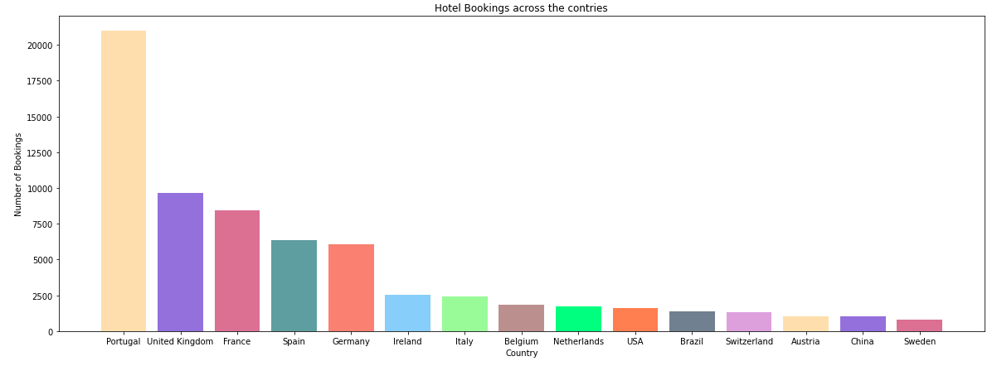
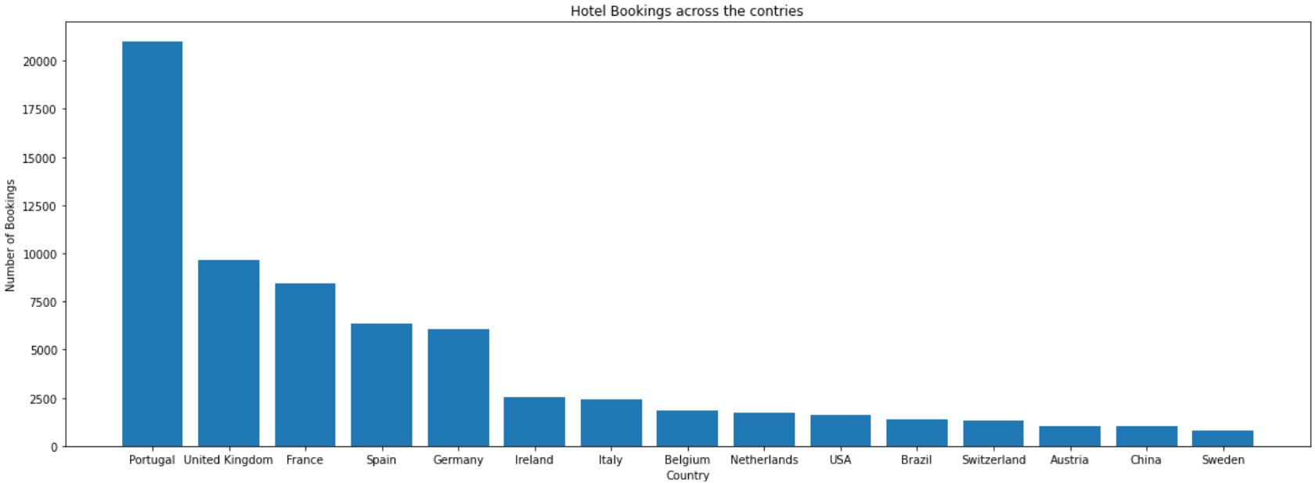
Country-wise Hotel Booking
Guests where coming from all over the world throughout the year from 2015 to 2017. The above bar graph shows the top 15 countries from where the guests come. Portugal brings in the mosts numbers of guests.

Slide 18
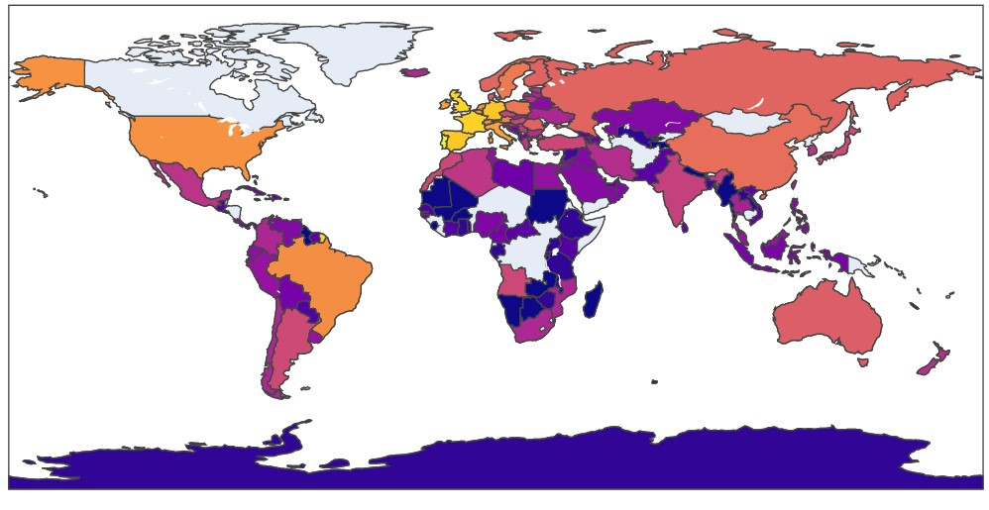

The above choropleth map shows that the European region collectively brings in the most number of bookings and the African region collectively brings in the least number of bookings.

Slide 19
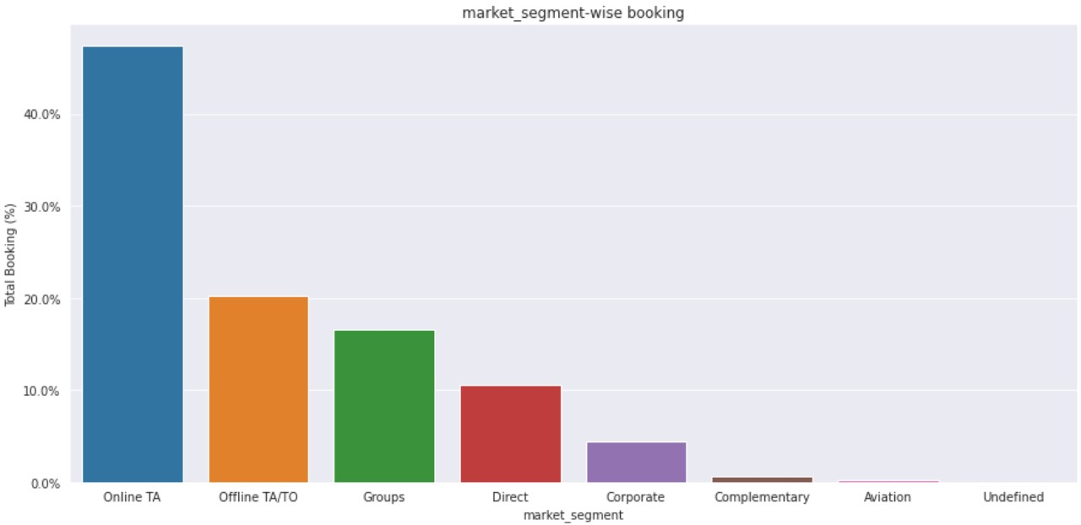
Market Segment-wise Hotel Booking Percentage
Inference: Online Travel Agents brings in more than 40% of the total bookings, followed by the Offline Travel Agents/Tour Operators brings in more than 20% of the total bookings.

Slide 20
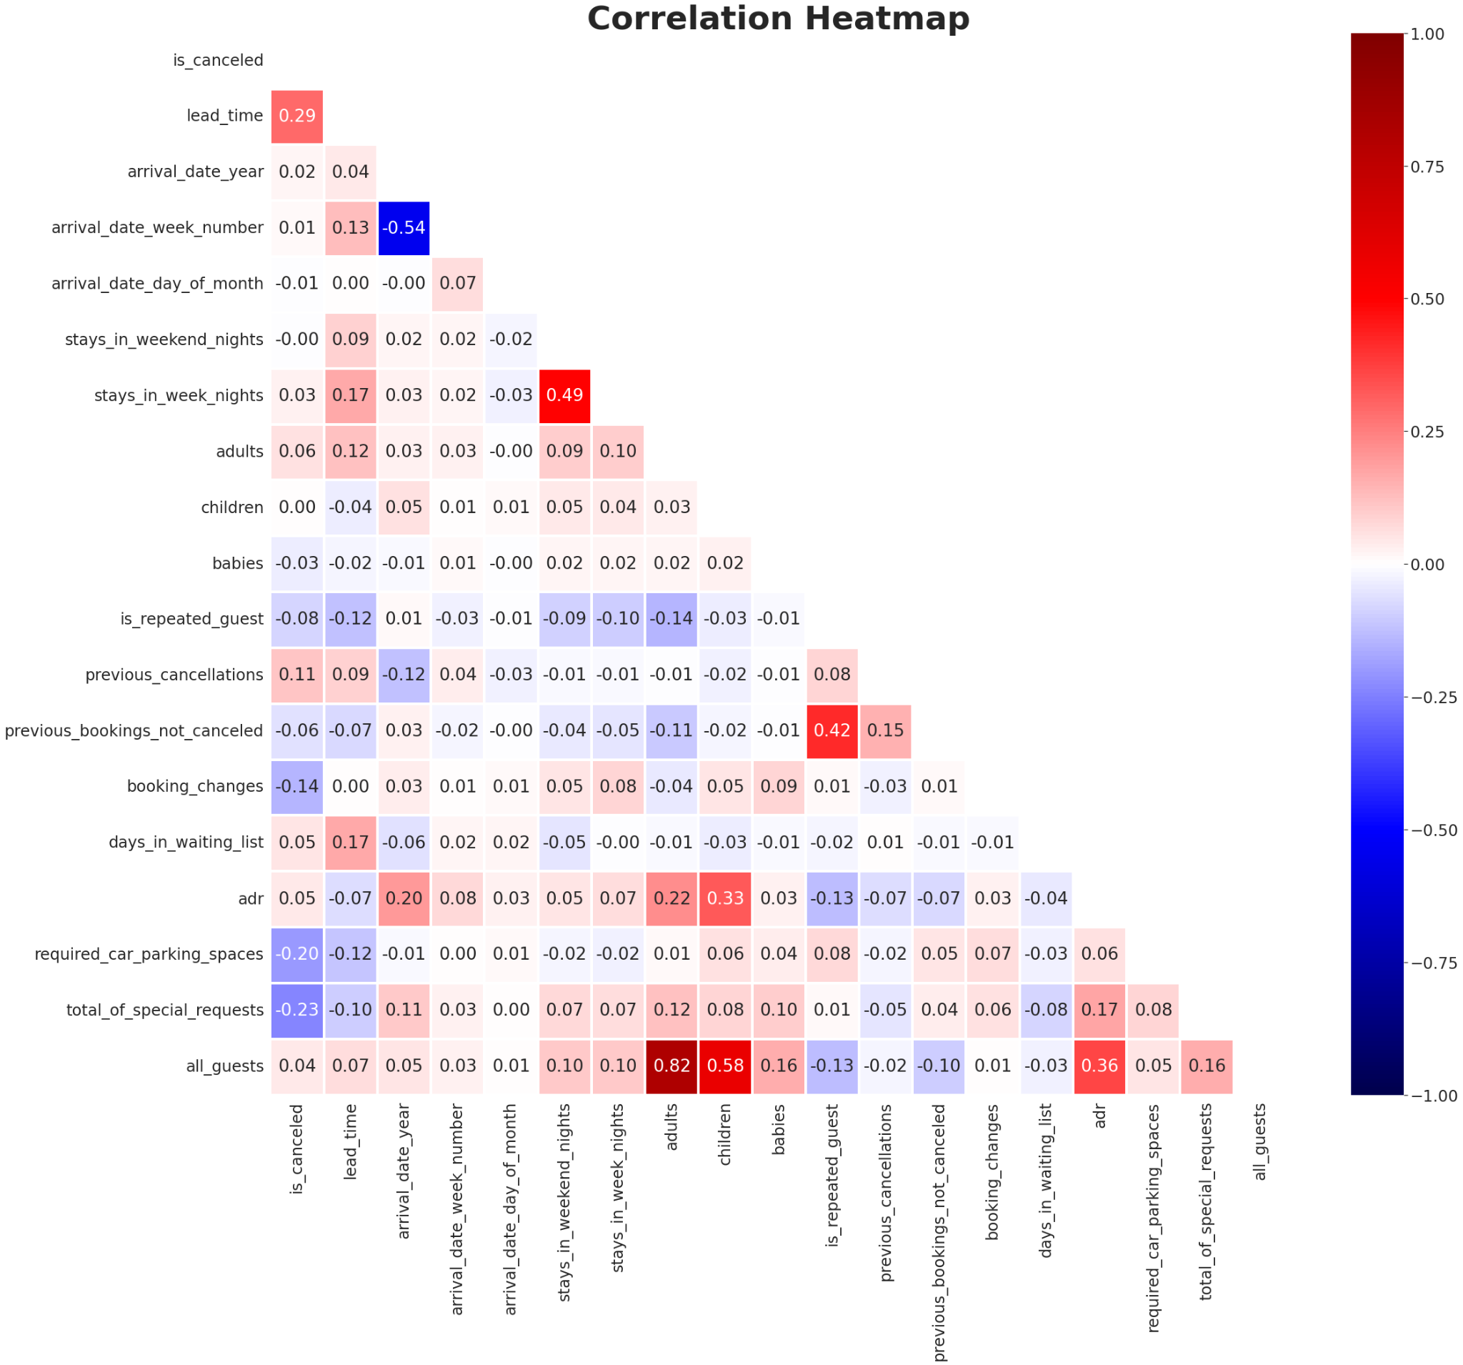
Correlation Heat Map Between All Features
Correlation Conclusion:
arrival_date_week_number and arrival_date_year are 54% negative correlated.
previous_bookings_not_cancelled and is_repeated_guest are 42% positive correlated.
Adr and children are positive correlated by 33%.

Slide 21
Conclusion:
'City hotels' and 'Resort hotels' are two types of hotels present in the dataset. 'City hotels are more preferred by the customers than the ‘Resort Hotel’ (66.4% customer prefers 'City hotels' whereas 33.6% customer prefers 'Resort hotels').
'August' month has highest number of hotel bookings whereas 'January' records the least.
Guests from PRT(Portugal) have got the maximum number of hotel bookings.
Its observed that 'City hotels' were more cancelled as compared to 'Resort hotels'.
'Online TA' brings maximum bookings.
'August' has got the highest average ADR in each year.

Slide 22
Conclusion: (Continue)
Its found that 77.3% of customers prefers BB(Bread & Breakfast).
Its observed that most of the customers rather guests do not repeat their bookings.
We can observe that in city hotels highest room ADR was for room type G and was lowest for the room type K. In case of Resort Hotels highest ADR was for room type H and was lowest for room type I.
It is observed that average daily count rate has decreasing trend after having peak value in August. This decreasing trend continues till month of January and after month of January ADR starts to increase and this trend is again observed till the month of August.
Each year ADR has been increasing consistently.

